Slide 1
R. LAkshmi PRIYA
IMT2015037.
DATACENTER TIErS

Slide 2
What is a DataCenter?

Slide 3
A data center (or datacenter) is a facility composed of networked computers and storage that businesses or other organizations use to organize, process, store and disseminate large amounts of data.
DATACENTER:

Slide 4
DATACENTER Challenges:
Power saving/cooling.
Physical Security.
Traffic load balancing.
Network Security and Management.

Slide 5
Tiers of a DATACenter:
1.Data centers can be defined by various levels of reliability or resilience.
2.In 2005, the American National Standards Institute (ANSI) and the Telecommunications Industry Association (TIA) published standard ANSI/TIA-942, "Telecommunications Infrastructure Standard for Data Centers," which defined four tiers of data center design and implementation guidelines. Each subsequent tier is intended to provide more resilience, security and reliability than the previous tier. For example, a tier 1 data center is little more than a server room, while a tier 4 data center offers redundant subsystems and high security.

Slide 6
Tiers of a DATACenter:
TIER 1 - Small businesses
TIER 2 - Medium-Size business
TIER 3 - Large businesses
TIER 4 - Enterprise corporations

Slide 8
Tier 4 Datacenter:

Slide 10
Tier V Datacenter(Switch):

Slide 11
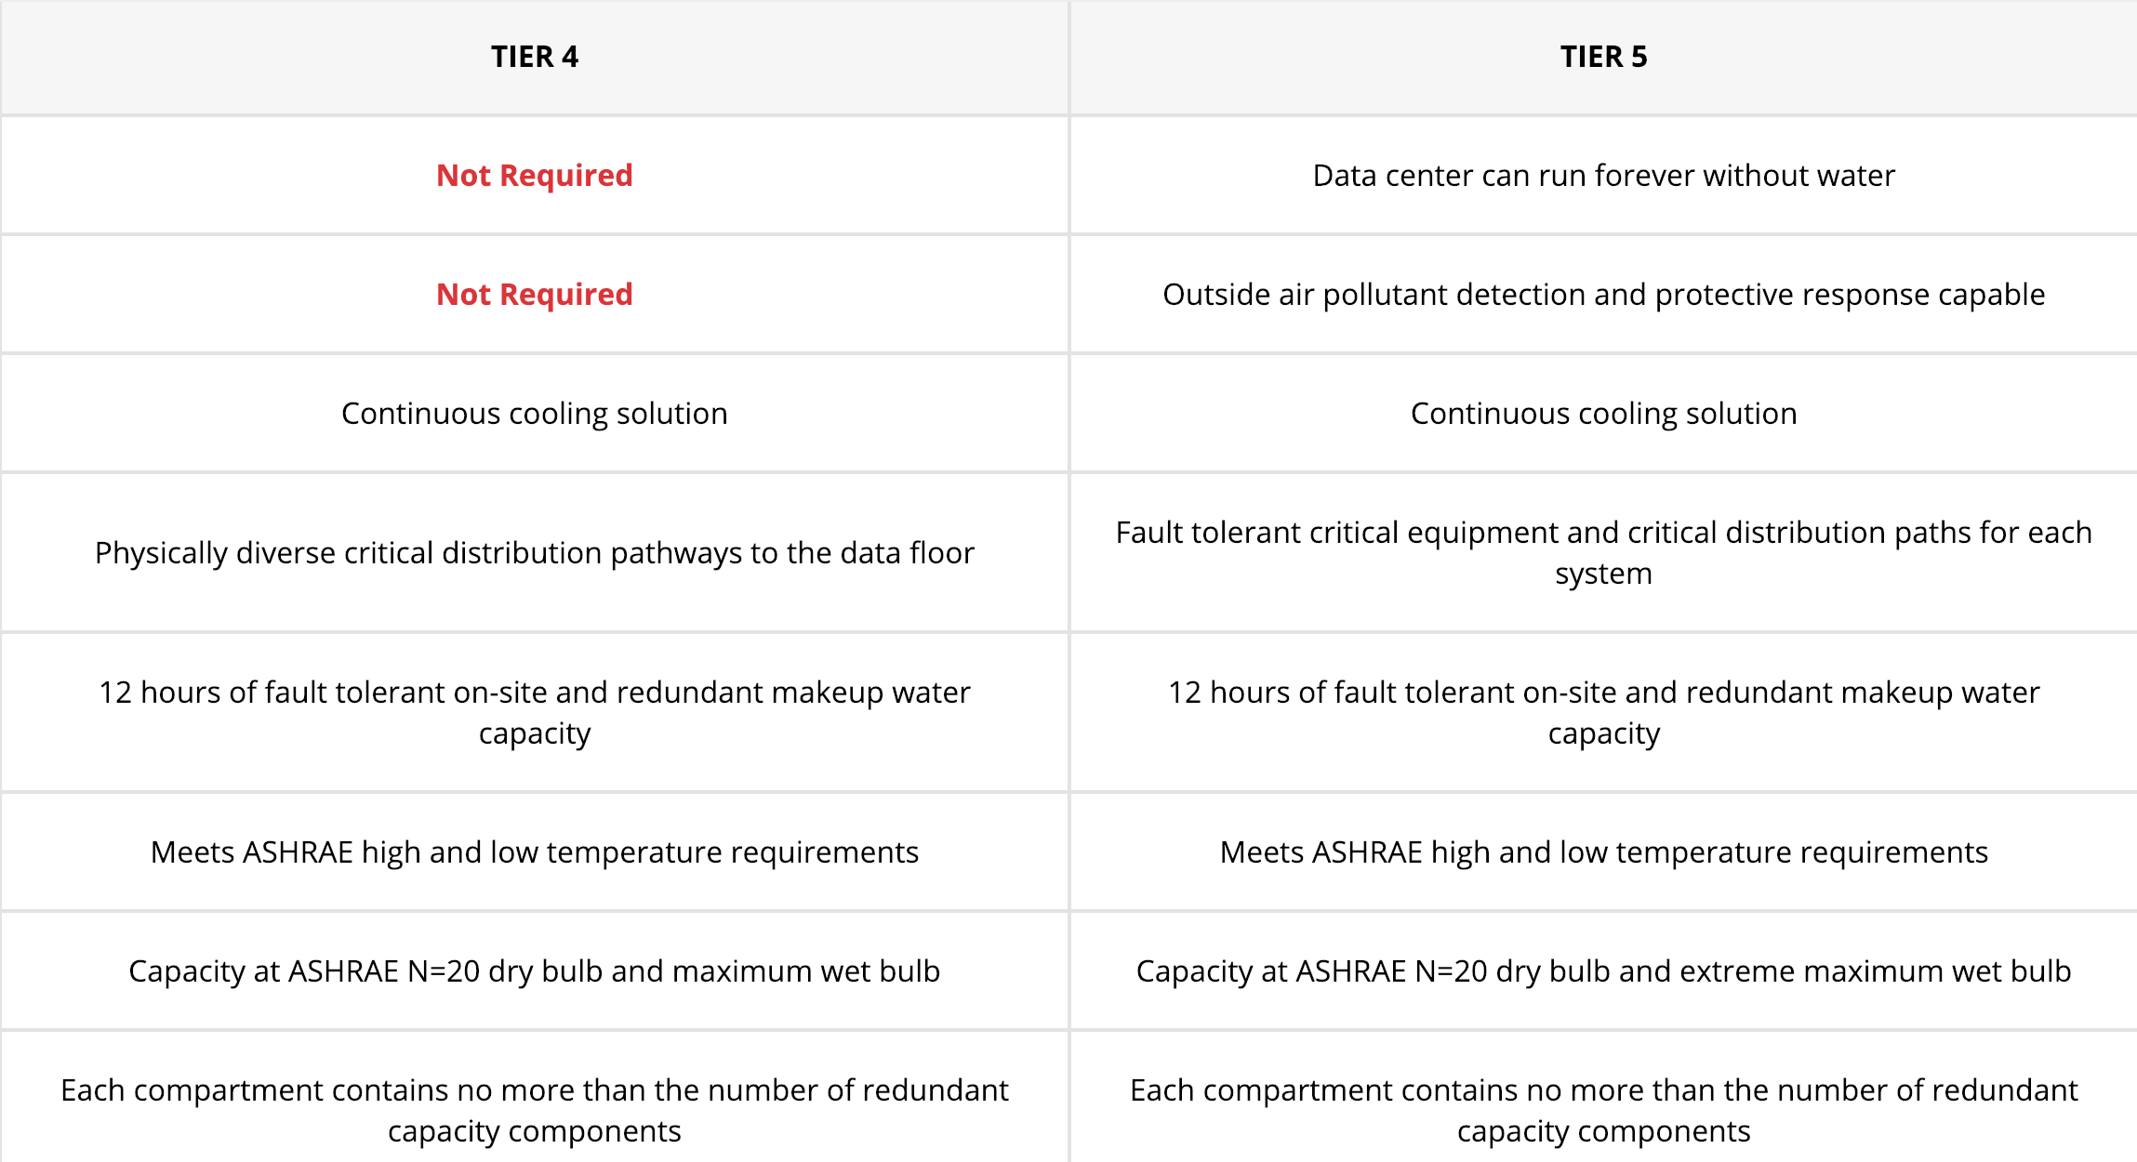
Switch(A Tier V Datacenter Differentiation)
Cooling Systems:

Slide 12
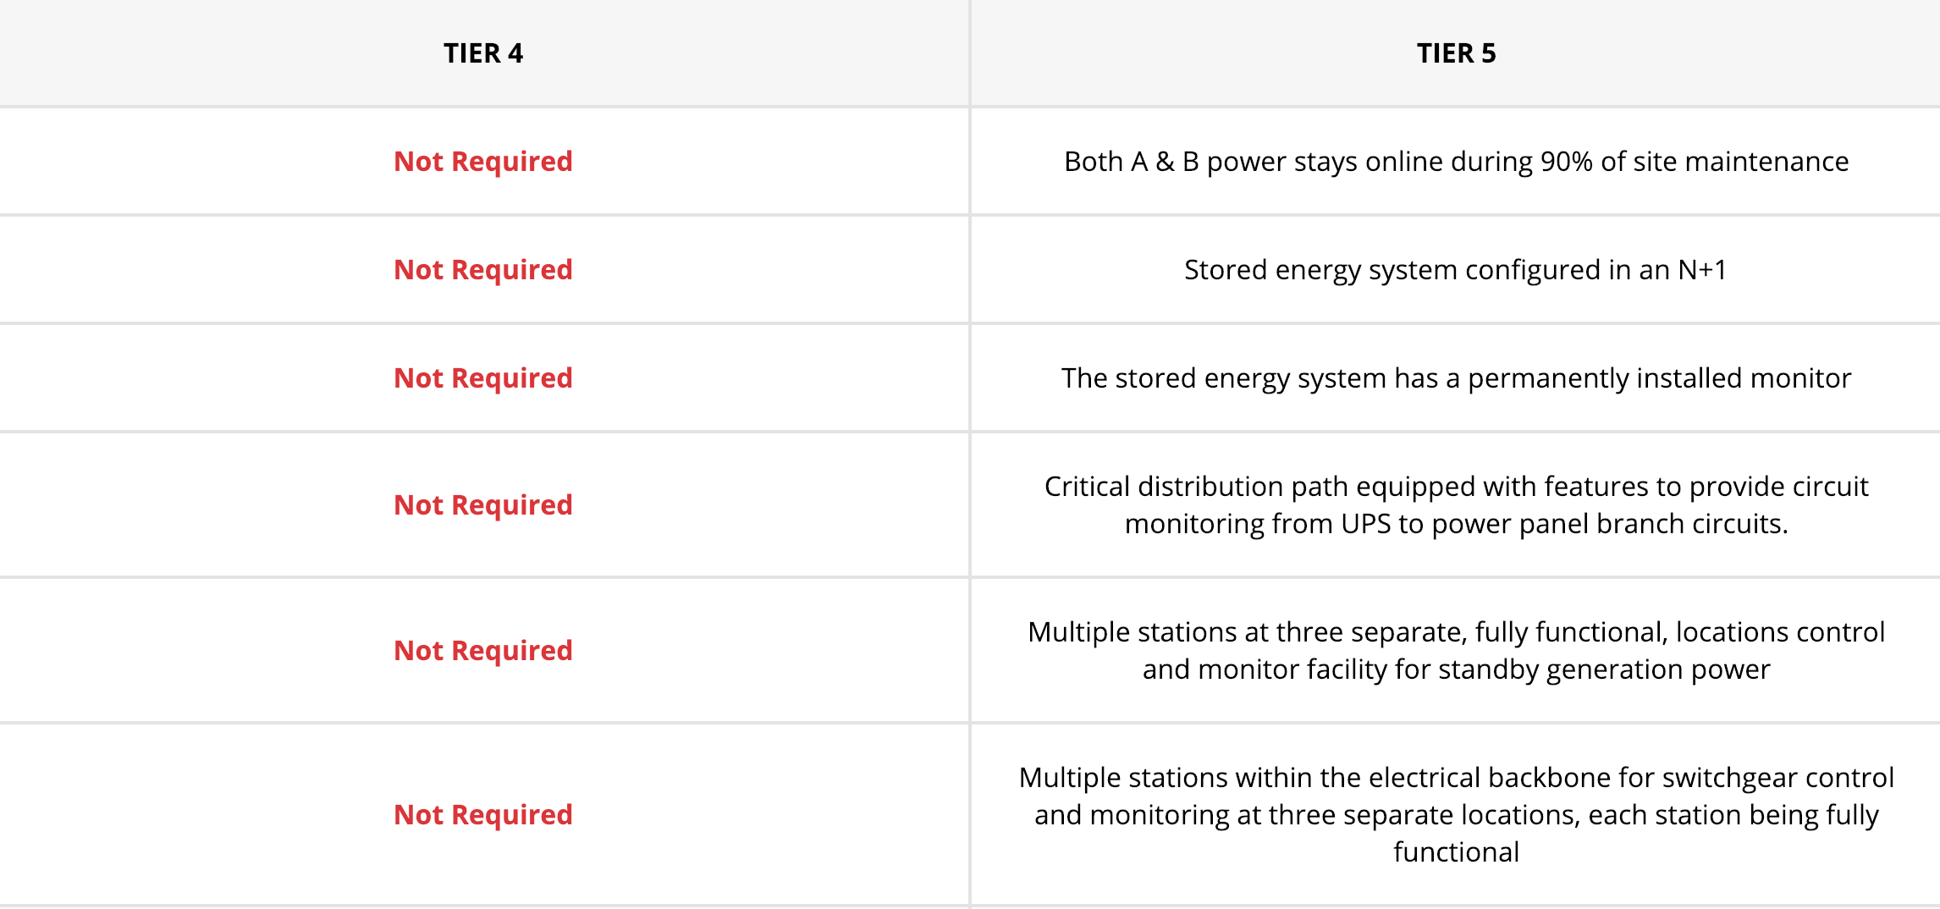
Switch(A Tier V Datacenter Differentiation)
Power Systems:

Slide 13
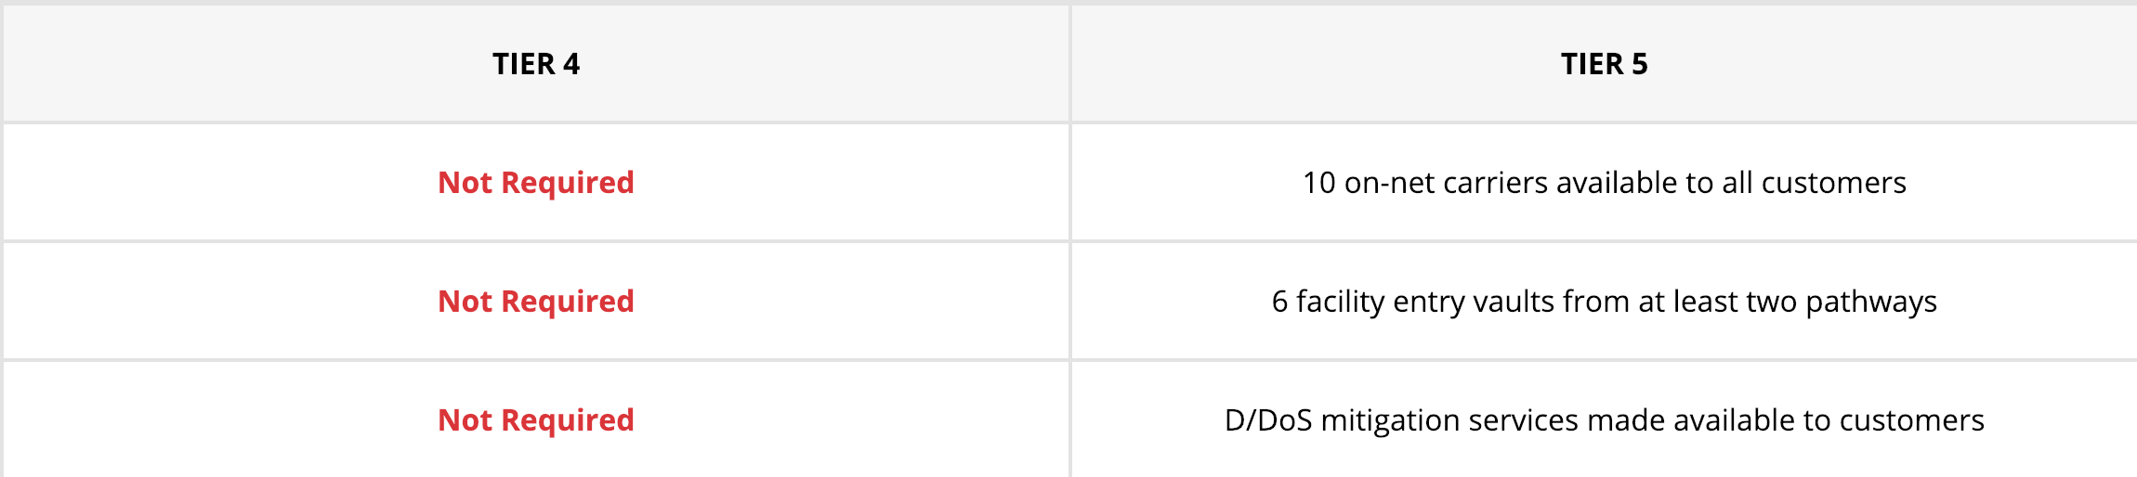
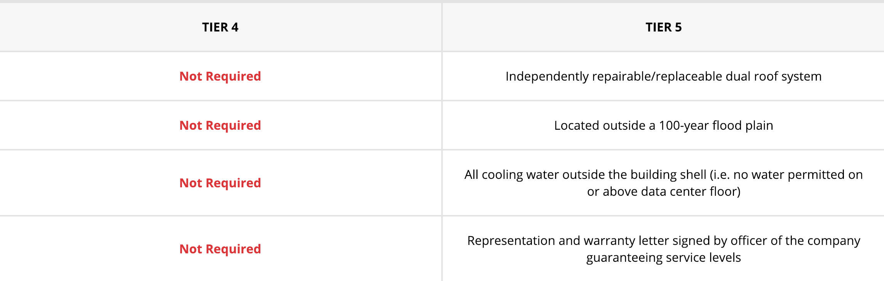
Switch(A Tier V Datacenter Differentiation)
Career Services:
Water Protection:

Slide 14
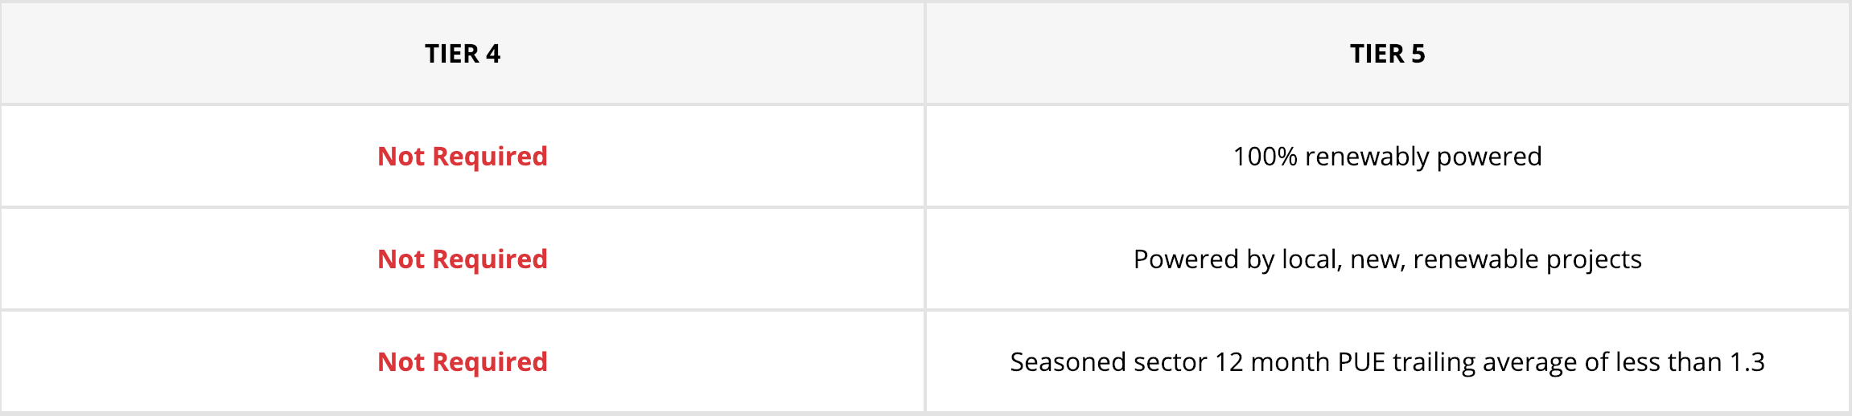
Switch(A Tier V Datacenter Differentiation)
Power Sustainability And Efficiency:

Slide 15
Switch(A Tier V Datacenter Differentiation)
Physical Security:
1.Each server rack is securable.
2.The facility within the premises has photo ID badged entry access control which records access times/dates/user for 180 days.
3.Exterior doors are reinforced (e.g. steel stiffened) in a steel frame which is fully grout filled and if unmanned without visible hinges.
4.Access control authenticates each badge holder by PIN/biometric/Two Person Integrity.
5.The security team conducts at least semi-annual security threat assessments in accordance with the facility's established quantitative and qualitative threat assessment methods.
6.No high-risk neighbouring facilities (e.g. highly flammable, explosive, HAZMAT, or nuclear risks)

Slide 16
Project Natick:
( Project Natick is an initiative launched in August 2014 by Microsoft for testing the feasibility of an energy-efficient, low-latency cloud computing facility on the ocean floor)
Why Microsoft Thinks Underwater Data Centers May Cost Less?

Slide 17
Project Natick:

Slide 18
Project Natick:
1.The Supply Chain is Largely in Place.
2.Lights-Out Means Warranty Savings.
(Sending the data center down for five or ten years at a time before replacing all the servers with new ones isn’t much different from the lifecycle of many cloud servers, which might get repurposed for different services as newer hardware comes in)
3.Scale Large and Small Possible
(It can be considerable distance between those things. If we have many of these in the water, it wouldn’t be all that different.)
4.The Green-Cloud Potential
5.No Added Strain on Local Resources
6.Humans and the Air They Breathe

Slide 19
References:
6 - https://www.google.com/search?q=tiers+of+data+center&source=lnms&tbm=isch&sa=X&ved=0ahUKEwjIoaWp957gAhVJLY8KHSCfBIkQ_AUIDigB&biw=1280&bih=641&dpr=2#imgrc=YEhcLoxiCf64-M:
7 - https://www.google.com/search?biw=1280&bih=641&tbm=isch&sa=1&ei=l4pWXMidBcHrvAT3oqioDA&q=tier+1+data+center&oq=tier+1+data&gs_l=img.3.0.0j0i24l9.5617.6373..7649...0.0..0.92.437.5......1....1..gws-wiz-img.......0i67j0i8i30.gHxpsp6WLkI#imgrc=_bwfJfK_HZAMtM:
11 to 15 - https://www.switch.com/tier-5/#compare
17 - https://www.iotforall.com/project-natick-underwater-data-centers/

